Slide 1
Basic of Networking
VishwanaTH m s
VISHWACLOUDLAB.com

Slide 2
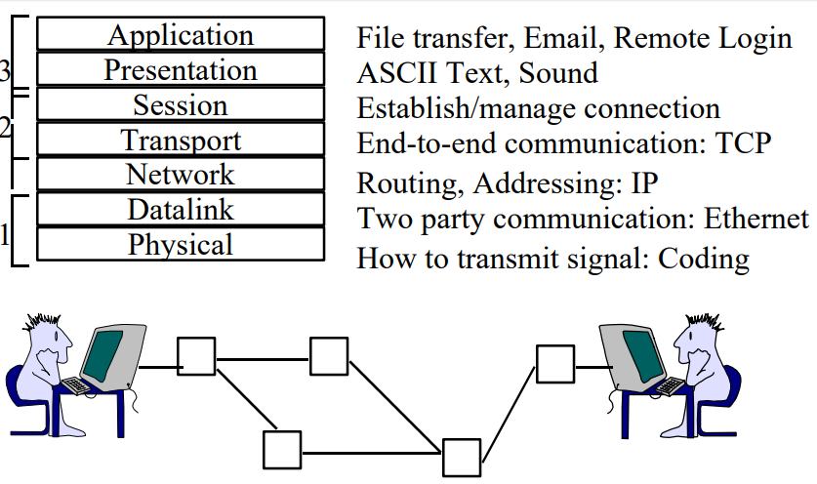
ISO/OSI Reference Model

Slide 3
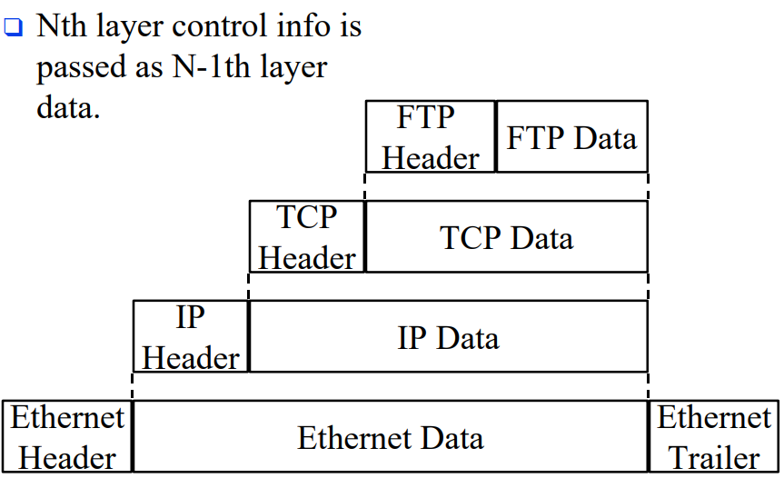
Layered Packet Format

Slide 4
Major Concepts in Network
Same Network – Switch
Different Network -- Router
PC – Traffic Generator
Switch and Router DOES NOT generate Traffic, they only manage it
IP Address – Its an tool used by PC for sending packets from Source to Destination

Slide 5



Network Diagram
10.0.0.1/8
172.100.0.1/16
Router
SW01
SW02
IP Add: 172.100.10.30
Subnet: 255.255.0.0
GW : 172.100.0.1
IP Add: 172.100.20.40
Subnet: 255.255.0.0
GW : 172.100.0.1
IP Add: 10.40.30.20
Subnet: 255.0.0.0
GW : 10.0.0.1
IP Add: 10.80.10.30
Subnet: 255.0.0.0
GW : 10.0.0.1

Slide 6
Basic Networking continued…..
Two types of IP address
IPv4 – 32 bit
IPV6 – 128 bit
Binary to Decimal Conversation
0000 0000 → 0 – Min Value
1111 1111 → 255 – Max Value
IPv4 address format
X .X .X .X
8bit 8bit 8bit 8bit
1st Octet 2nd Octet 3rd Octet 4th Octet
00000000.00000000.00000000.00000000

Slide 7
Binary to Decimal Conversion & ViceVersa
Find Decimal value of below Binary octets
Eg1: - 10010001
Eg2: - 1110001 1
2^7 2^6 2^5 2^4 2^3 2^2 2^1 2^0
128 64 32 16 8 4 2 1
Eg1: - 1*128 + 0*64 + 0*32 + 1*16 + 0*8 + 0*4 + 0*2 + 1*1 → 128+16+1 = 145
Eg2: - 1 1 1 0 0 0 1 1 → 128+64+32+2+1 = 227
Eg3: - 1 1 0 0 1 1 0 0 → ???
Eg4: - 1 0 1 0 1 0 1 0 → ???

Slide 8
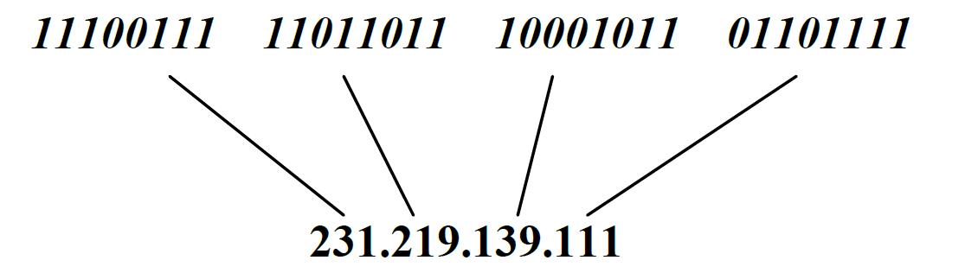
IP address V4
An IP address is a 32-bit address and are unique.
The address space of IPv4 is 2^32 or 4,294,967,296.

Slide 9
IP Address IPV4
CLASS A – 0.0.0.0 to 127.255.255.255 --- USED FOR PUBLIC NETWORK, UNICAST TRAFFIC
CLASS B – 128.0.0.0 to 191.255.255.255 --- USED FOR PUBLIC NETWORK, UNICAST TRAFFIC
CLASS C – 192.0.0.0 to 223.255.255.255 --- USED FOR PUBLIC NETWORK, UNICAST TRAFFIC
CLASS D – 224.0.0.0 to 239.255.255.255 --- USED FOR MULTICAST
CLASS E – 240.0.0.0 to 255.255.255.255 --- USED FOR RESEARCH
Class A - 00000000 to 01111111
Class B - 10000000 to 10111111
Class C - 11000000 to 11011111
Class D - 11100000 to 11101111
Class E - 11110000 to 11111111

Slide 10
IP Address Classes
RFC 791 defines the IP protocol.
Note: -- The valid addresses in class A start from 1 to 126. Network 0.0.0.0 is defined for use as
a broadcast address and 127.0.0.0 is reserved for use as loopback address.

Slide 11

Default Subnet Mask
Class A – 255.0.0.0 – 11111111.00000000.00000000.00000000 -- /8
Class B – 255.255.0.0 – 11111111. 11111111.00000000.00000000 -- /16
Class C – 255.255.255.0 – 11111111. 11111111. 11111111.00000000 -- /24
CLASS A – 0.0.0.0 to 127.255.255.255 --- USED FOR PUBLIC NETWORK, UNICAST TRAFFIC
CLASS B – 128.0.0.0 to 191.255.255.255 --- USED FOR PUBLIC NETWORK, UNICAST TRAFFIC
CLASS C – 192.0.0.0 to 223.255.255.255 --- USED FOR PUBLIC NETWORK, UNICAST TRAFFIC
CLASS D – 224.0.0.0 to 239.255.255.255 --- USED FOR MULTICAST
CLASS E – 240.0.0.0 to 255.255.255.255 --- USED FOR RESEARCH

Slide 12
Roles of Router, Switch and PC
Router → Determines the path to the different destination Network
Switch → Transports the traffic from SRC and DST on same network on HIGH SPEED
PC → Determines whether the SRC IP and DST IP are SAME or DIFFERENT network.
SRC – Source
DST -- Destination

Slide 13
PC determines whether Src IP and Dst Ip are in same or Diff network
PC does an “BINARY AND” operation between
SRC IP BINARY AND SRC SUBNETMASK
&
DST IP BINARY AND SRC SUBNETMASK
0 AND 0 = 0
0 AND 1 = 0
1 AND 0 = 0
1 AND 1 = 1

Slide 14
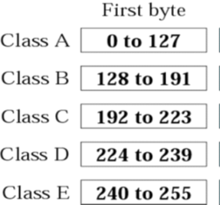
PC - Operations
Example:1 Src IP – 10.40.30.20 and Dst IP – 10.80.10.30
Src IP AND Src SubnetMask
00001010. 00101000.00011110.00010100 → 10.40.30.20 – Src IP
11111111. 00000000.00000000.00000000 → 255.0.0.0 -- Src Subnet mask
00001010. 00000000.00000000.00000000 → 10.0.0.0
10.0.0.0/8 is the Network ID for “10.40.30.20”
AND
0 AND 0 = 0
0 AND 1 = 0
1 AND 0 = 0
1 AND 1 = 1
DST IP AND Src SubnetMask
00001010. 01010000.00001010.00011110 → 10.80.10.30 – DST IP
11111111. 00000000.00000000.00000000 → 255.0.0.0 -- SRC Subnet Mask
00001010. 00000000.00000000.00000000 → 10.0.0.0 ← Result
10.0.0.0/8 is the Network ID for “10.80.10.30”
AND

Slide 15
CONCLUSION of AND operation:
Since the network ID’s of the SRC IP and DST IP are the same they are in the same network.

Slide 16
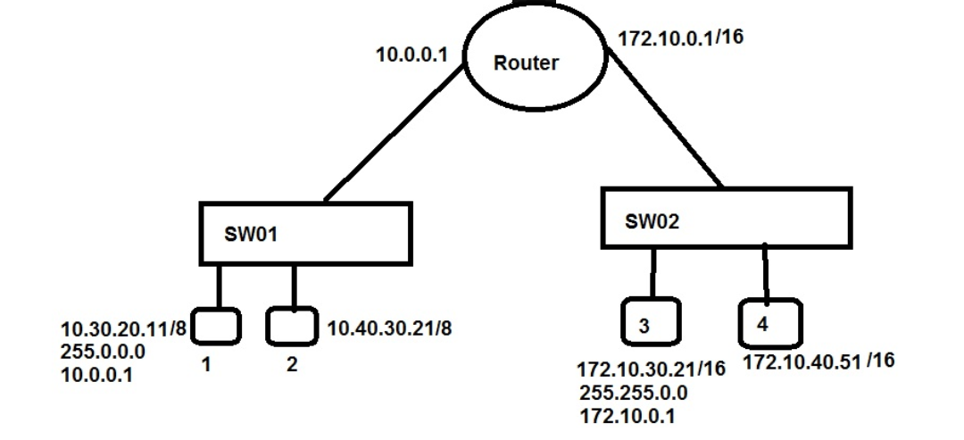
Traffic flow for Same Network
PC1: Requests for MAC ID of the PC2 to the switch
SW01: Does an Broadcast for the first time only
PC2: Replies to the broadcast with its MAC ID
SW01: passess the info to PC1
PC1: Send data to PC2.
PC2: Replies to the data to PC1

Slide 17
PC - Operations
Example:2 Src IP – 10.40.30.20 and Dst IP – 11.81.11.31
Src IP AND Src SubnetMask
00001010. 00101000.00011110.00010100 – 10.40.30.20
11111111. 00000000.00000000.00000000 – 255.0.0.0
00001010. 00000000.00000000.00000000 – 10.0.0.0
Statement → 10.0.0.0/8 is the Network ID for “10.40.30.20”
DST IP AND Src SubnetMask
00001011. 01010001.00001011.00011111 – 11.81.11.31
11111111. 00000000.00000000.00000000 – 255.0.0.0
00001011. 00000000.00000000.00000000 – 11.0.0.0
Statement → 11.0.0.0/8 is the Network ID for “11.81.11.31”
Results:
The Network ID’s are different, so they are in different network.

Slide 18
PC - Operations
Example:3 Src IP – 10.40.30.20 and Dst IP – 172.100.10.30
Src IP AND Src SubnetMask
00001010. 00101000.00011110.00010100 → 10.40.30.20
11111111. 00000000.00000000.00000000 → 255.0.0.0
00001010. 00000000.00000000.00000000 → 10.0.0.0
10.0.0.0/8 is the Network ID for “10.40.30.20”
DST IP AND Src SubnetMask
10101100. 01100100.00001010.00011110 → 172.100.10.30
11111111. 00000000.00000000.00000000 → 255.0.0.0
10101100. 00000000.00000000.00000000 → 172.0.0.0/8
172.0.0.0/8 is the Network ID for “172.100.10.30”
Results:
The Network ID’s are different, so they are in different network.

Slide 19
PC – Operations – Example -4
Example:4 Src IP 172.100.10.30 and DST IP – 192.168.25.20
Since the SRC ip is Class B , we have to consider Class B subnet mask
Source
172.100.10.30 → SRC IP
255.255.0.0 → SRC Subnet Mask
--------------------
172.100.0.0/16
Destination
192.168.25.20 → DST IP
255.255.0.0 → SRC Subnet Mask
--------------------
192.168.0.0/16

Slide 20
Traffic flow for Different Network
PC1: Requests for MAC ID of the default Router(Default Gateway)
SW01: Does Broadcast for the first time to get the MAC ID of the Router interface
RT: Replies to the Broadcast with its MAC ID
SW01: Replies to the PC1 with MAC ID of the Router
PC1: Send’s Packet to RT to forward it to the DST network (PC3)
RT: Checks the Routing Table for the forwarding of the packet.
RT: Sends an Broadcast request to the switch (SW02) to get
the MAC ID of the PC3 for first time
PC3: replies the Broadcast
RT: Forwards the request to the PC3.

Slide 21
Netid and Hostid
In classful addressing, an IP address in class A, B and C is divided into two parts netid and hostid. These parts are varying length, depending on the class of the address.

Slide 22
Conclusion of the AND operation
If the 1st Octet in CLASS A is same for both SRC IP and DST IP , then they are in the same network, if not they are in Different Network.
If the 1st & 2nd Octet in CLASS B is same for both SRC IP and DST IP , then they are in the same network, if not they are in Different Network.
If the 1st, 2nd & 3rd Octet in CLASS C is same for both SRC IP and DST IP , then they are in the same network, if not they are in Different Network.

Slide 23
Some Example
20.30.40.50 & 20.20.30.10 -- ?????
They are in the CLASS-A network and the 1st octet is same, means they are in the same N/W.
200.30.10.10 & 200.31.10.20 -- ????
They are in Class-c and the 1st 3 Byte is NOT same. – Diff Network
150.140.130.120 & 150.140.120.130 -- ????
They are in the Class-B and 1st 2 Octet are SAME. Hence they are in same Network

Slide 24
First and Last Usable IP & Broadcast IP
Src IP AND Src SubnetMask -- 10.40.30.20 AND 255.0.0.0
00001010. 00101000.00011110.00010100
11111111. 00000000.00000000.00000000
00001010. 00000000.00000000.00000000
10.0.0.0/8 is the Network ID for “10.40.30.20”
First IP –NW ID→ 00001010.00000000.00000000.00000000 – 10.0.0.0
First Usable IP → 00001010.00000000.00000000.00000001 – 10.0.0.1
Last Usable IP → 00001010.11111111.11111111.11111110 – 10.255.255.254
Broadcast IP → 00001010.11111111.11111111.11111111 – 10.255.255.255

Slide 25
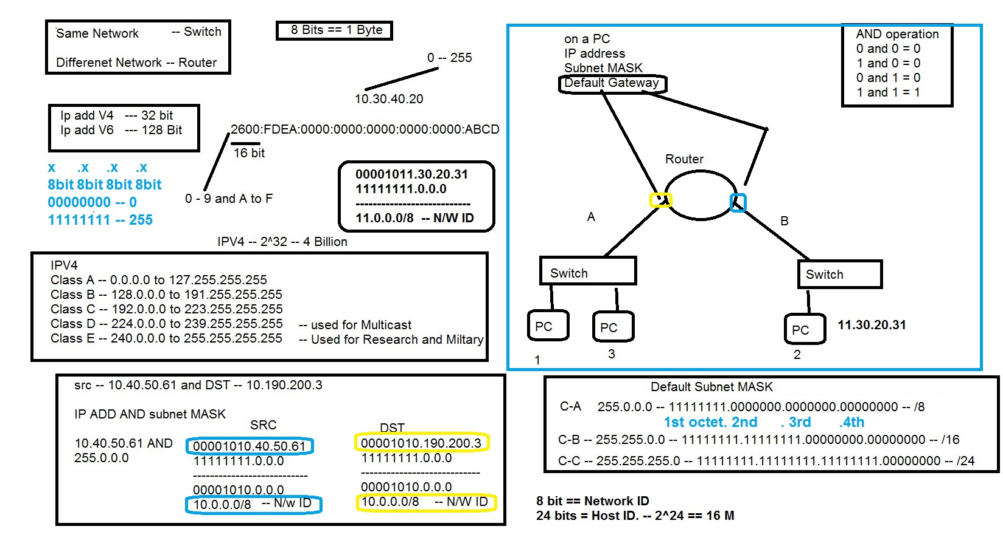
Summary

Slide 26
Problem
Scenario 1 .
Customer 1 wants 5000 IP’s in a single network
Customer 2 wants 10000 IP’s in a single network

Slide 27

Number of Networks and Hosts Per each Network
CLASS A ---- NNNNNNNN.HHHHHHHH.HHHHHHHH.HHHHHHHH
Subnet Mask - 255 . 0 . 0 . 0
28= 0-126 224= 16,777,216
CLASS B ---- NNNNNNNN.NNNNNNNN.HHHHHHHH.HHHHHHHH
SubnetMask - 255 . 255 . 0 . 0
216= (128-191)*256 = 16K 216= 65,536
CLASS C ---- NNNNNNNN.NNNNNNNN.NNNNNNNN.HHHHHHHH
subnetMask - 255 . 255 . 255 . 0
224= (192-223)*256*256 = 2M 28= 256
H == HOST == IP ADDRESS == VM == Laptop == Desktop

Slide 28
Solution to the Problem
Scenario 1 .
Customer 1 wants 5000 IP’s in a single network
Customer 2 wants 10000 IP’s in a single network
Solution.
Provide each Customer with a CLASS B network.
140.140.0.0/16
140.141.0.0/16

Slide 29
Problem Due to IPV4 Classes
In networking world, if we need to control traffic , it can be done in an controlled way Between DIFFERENT NETWORK.
It’s very very TOUGH to control traffic within the same network.
Means Class A and B are having huge Amount of HOSTS in each network, and we would start wasting IP’s by assign each network to individual Customers.
Solution to this Problem is “SUBNETTING”

